Slide 1
Shortest Path Among Obstacles
Daniel Plotnicov, Mihai Alexandru Tanasa, Paul Alexandru Ungur

Slide 2
The Problem
A common challenge in robotics, navigation, and gaming is determining the shortest path among obstacles. The objective is to navigate the shortest route through an obstacle-filled space between two spots.
It can be resolved using methods that account for the presence of obstacles and the expense of navigating them, like Dijkstra's algorithm or the A* algorithm.

Slide 3
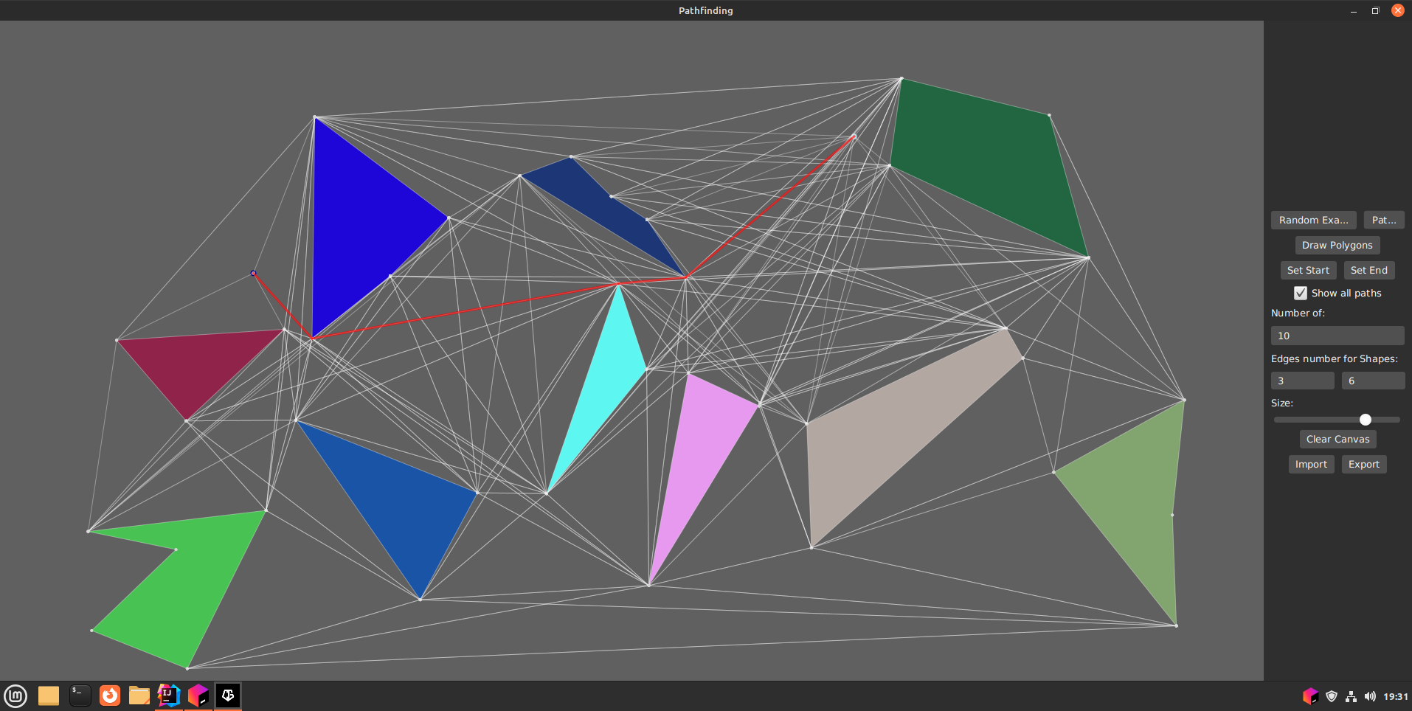
The Solution

Slide 4
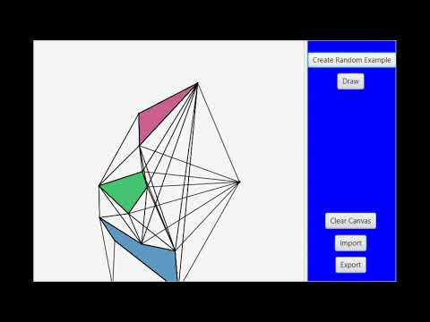
Early Demo

Slide 5
Quickstart
You can obtain random polygons and start/end points by selecting the "Random Example" button. From the text fields, you may select the number of polygons and edges.
The size of the shape is selected using the slide.
You can also display the whole graph by checking the the box.

Slide 6
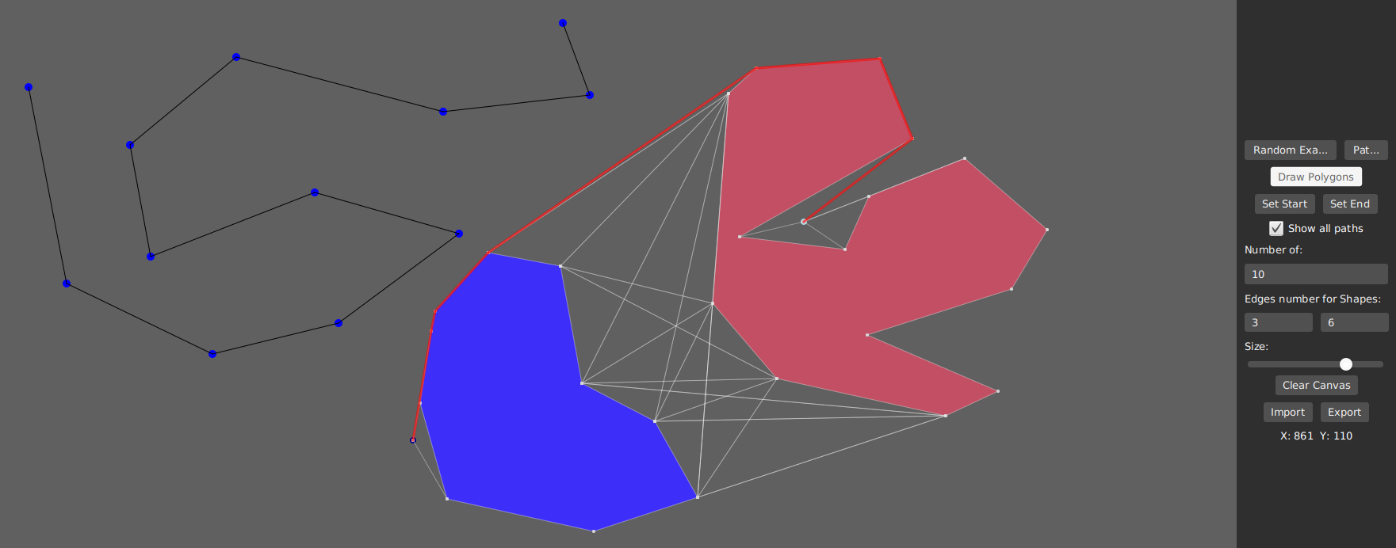
Features
With "Draw Polygon," users can make their own polygons. Once it is toggled, draw the necessary number of points to produce the desired polygon.
Then, using "Set Start" and "Set Finish," set the start and end positions.
To start anew click “Clean Canvas”.

